Slide 1

Programming with python
Kimberly preece

Slide 2

Overview
Utilizing Anaconda3, Spyder and online resources to create a weather data bank using Python, SQL and Excel.

Slide 3

Week two
Start
Install Python
Download weather data to a database
Extract weather data from the database into a python comma separated file.
Prepare for transfer of Weather Data
Cleanse the weather data.
Week one focuses planning and preparation. This includes developing the flow chart and downloading the NOAA-SDK library .
Manipulate data using Excel.
Develop graphical models using pythons analytic modules.
Stop

Slide 4

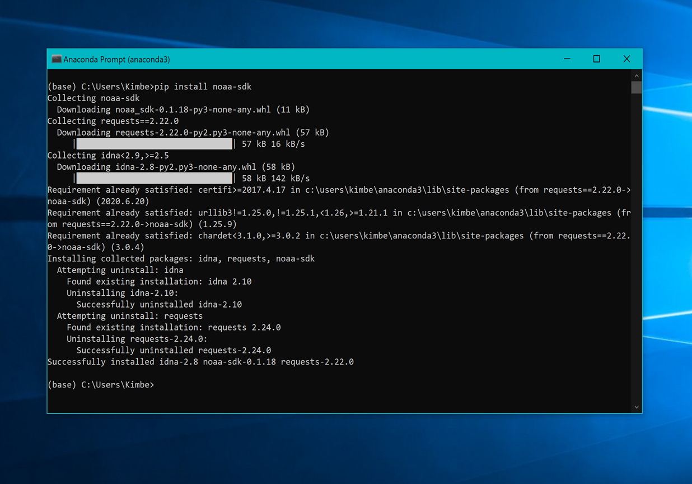
Installation of noaa-sdk library

Slide 5
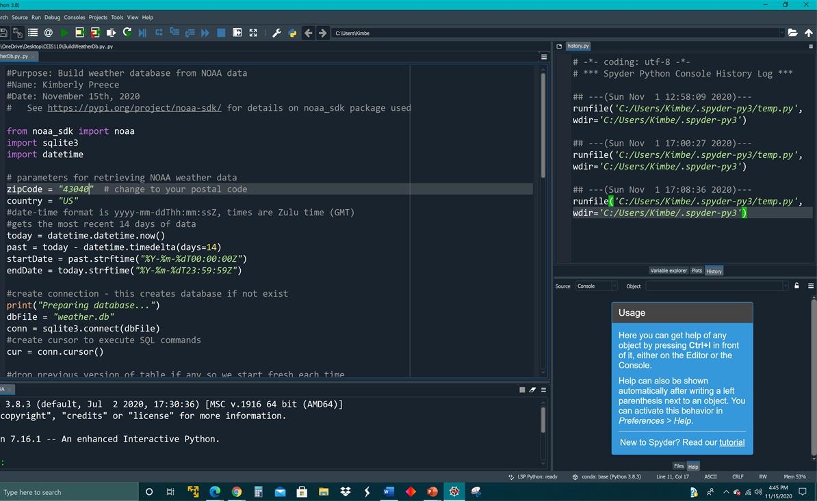
Week three
The focus for this week was create our weather data files that would be cleansed and used in our excel programs.
Here we have created a program within Spyder to retrieve and store our data from the NOAA-SDK database from the previous week.

Slide 6
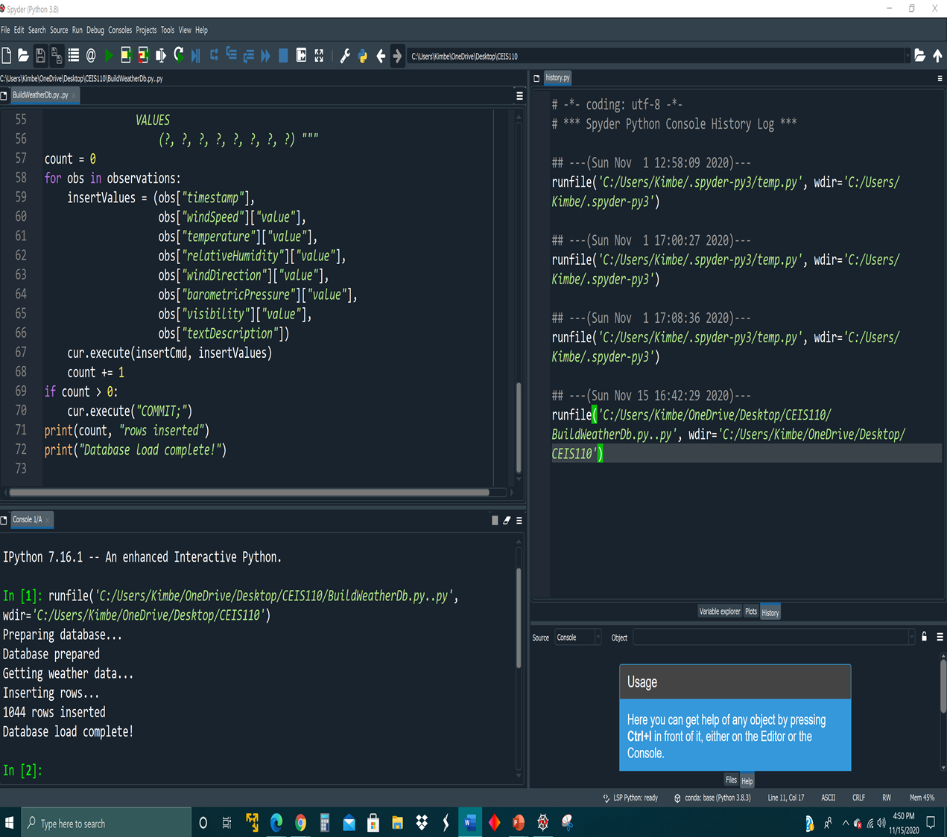
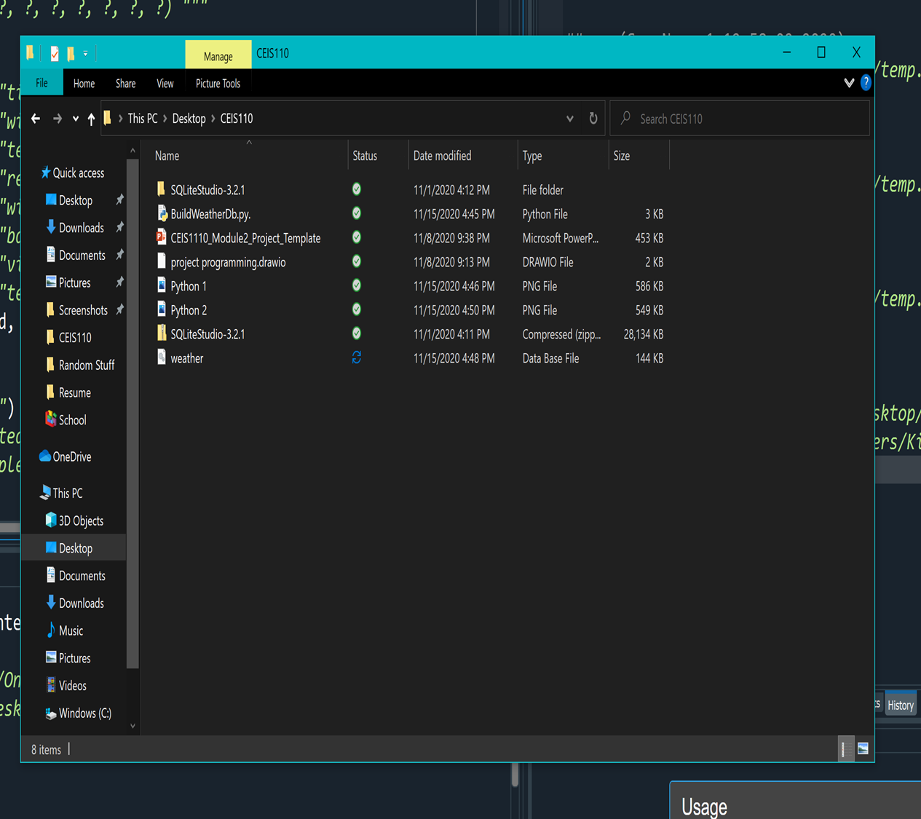
Building the BuildWeatherDb.py database file
After running the program, we can see it was successful in creating our database files.

Slide 7
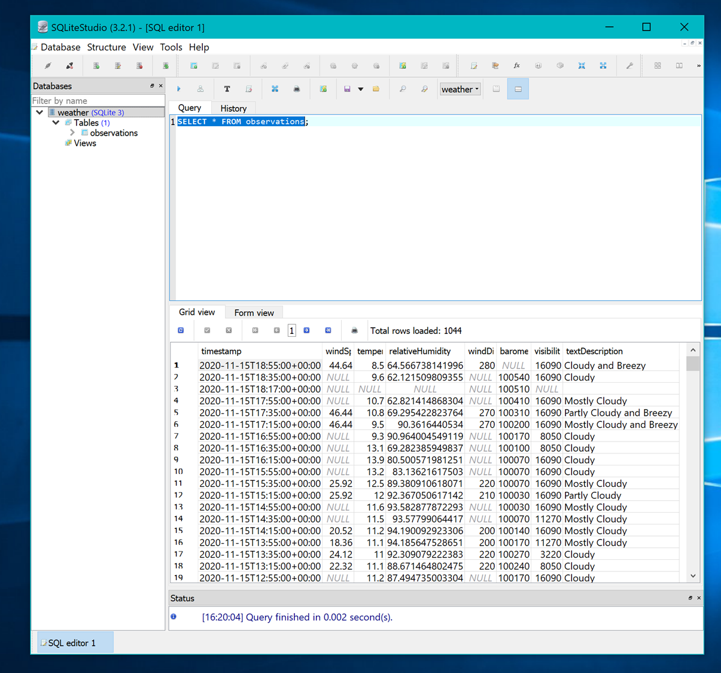
Week four- Extracting data with SQl query command
We used SQLiteStudio to run a SQL command to extract the data from our BuildWeatherDb.py file database.

Slide 8
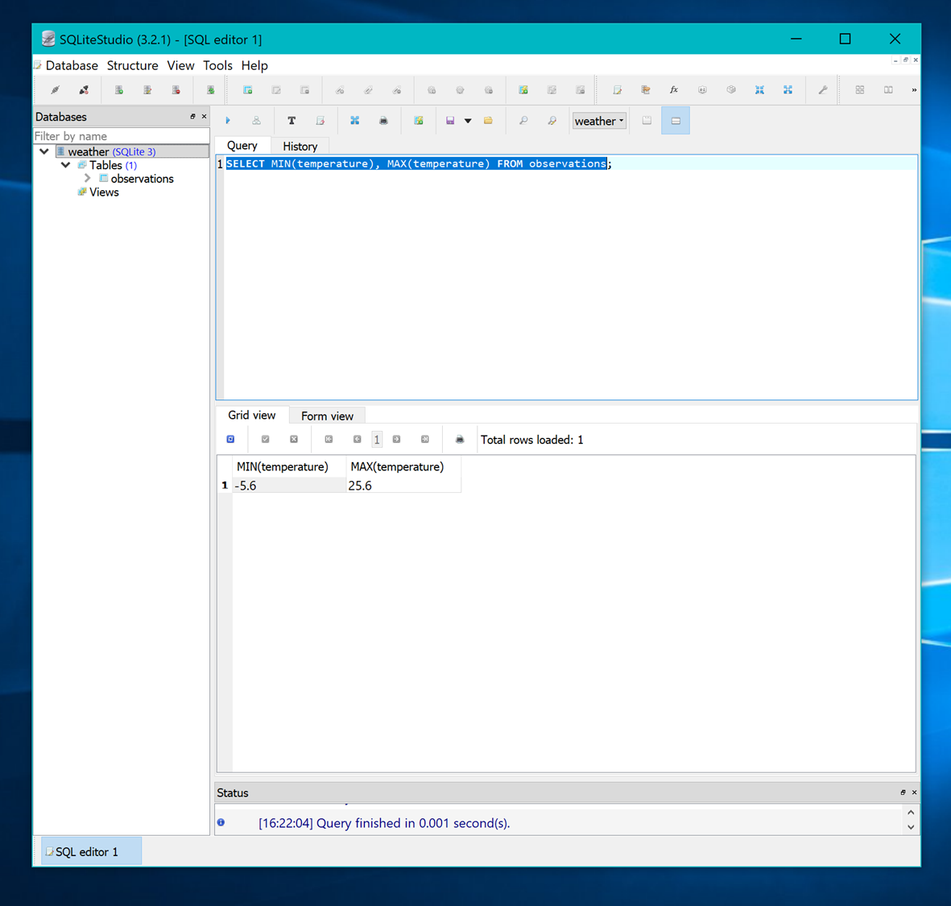
Here we have narrowed our database down to the min and max temperatures recorded.

Slide 9

Week five
Manipulating data with SQL and Python

Slide 10
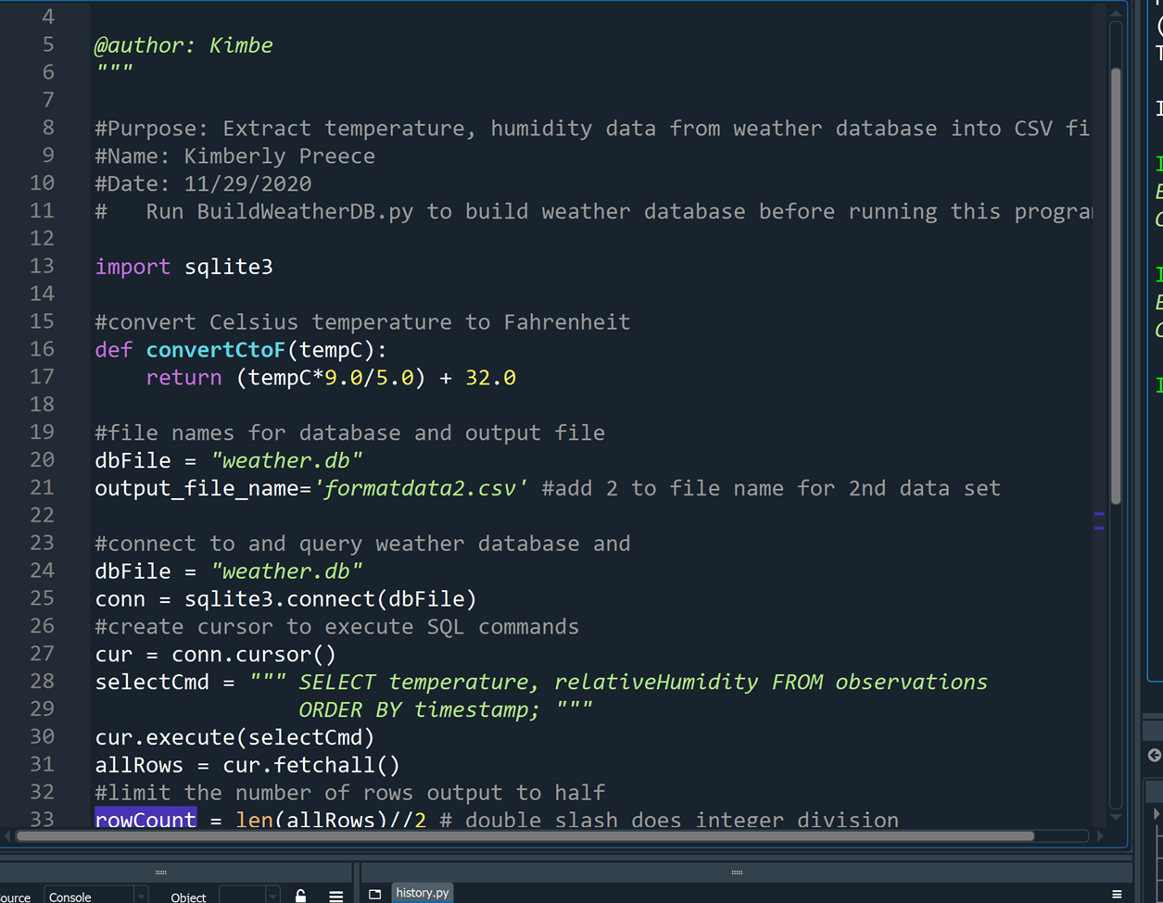
Python Extraction
This python code shows us that we have pulled our data from the weather.db and made an output to formatdata2.csv file while executing SQL commands to pull specific data.

Slide 11
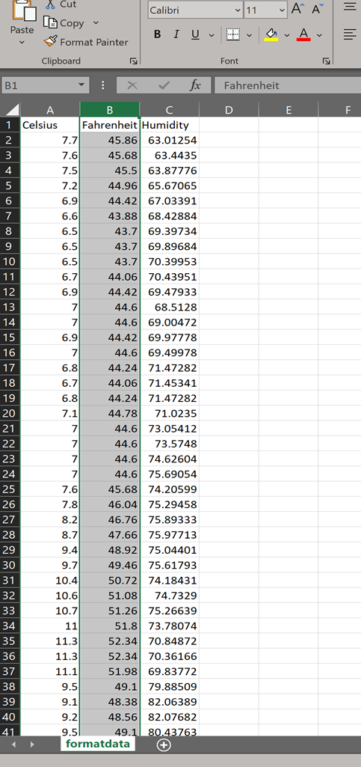
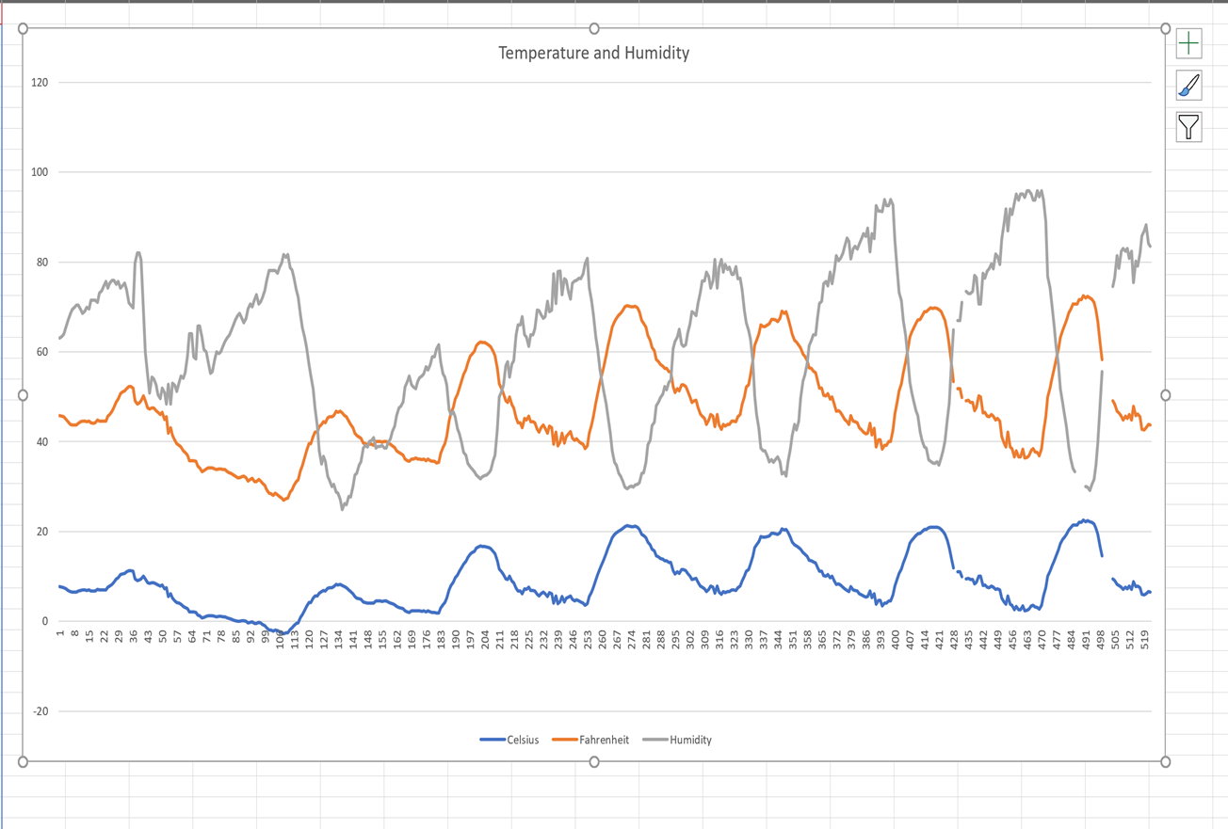
Extracted data shown in Excel then used to created a simple chart showing fluctuation in Temperature and Humidity.

Slide 12
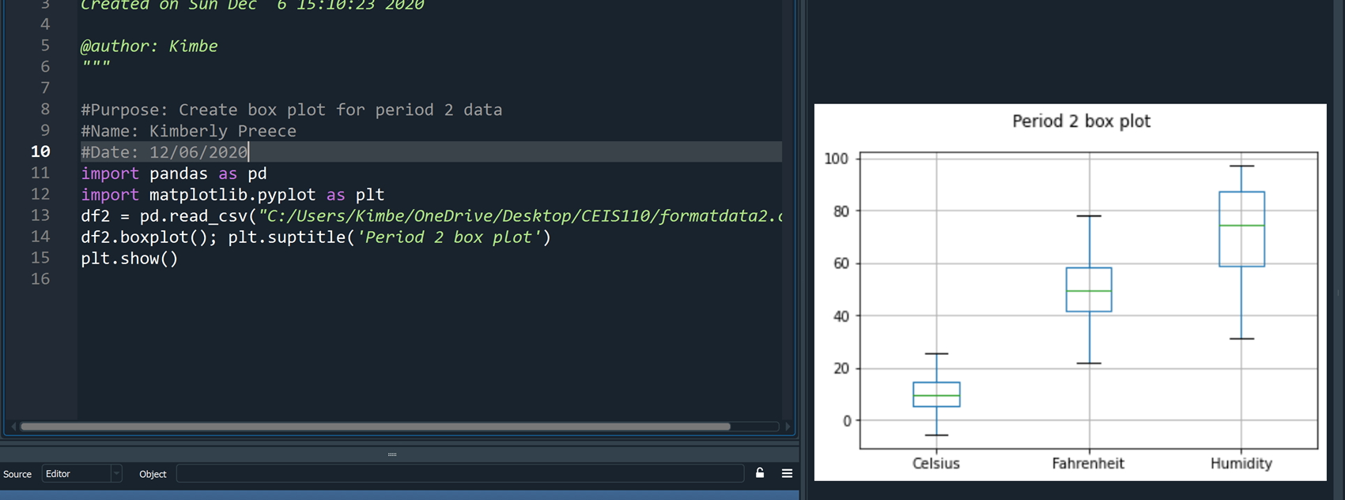
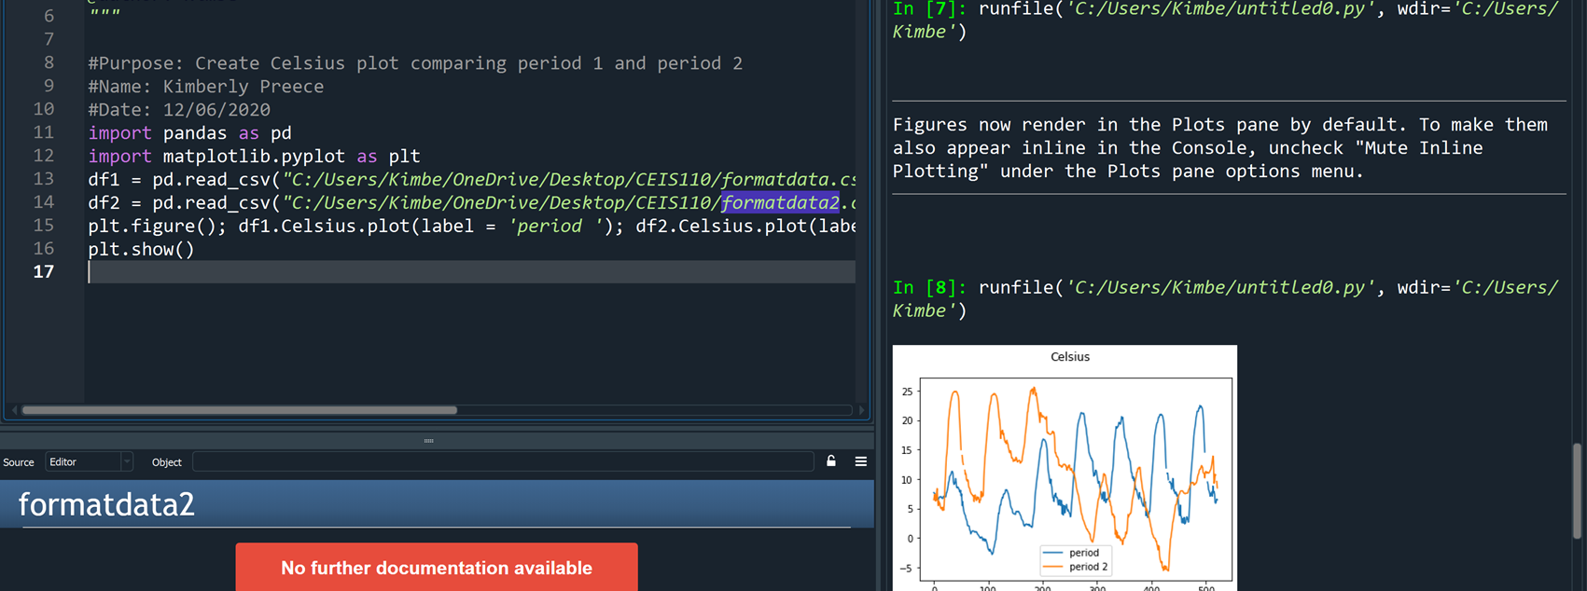
WEEK SIX- Developing Graphic Models and Interpreting Results.
Here we use Spyder to pull data from the formatdata2.csv file to create plots with in our Spyder program.
We create two different types of plots while exploring the differences in code structure.

Slide 13
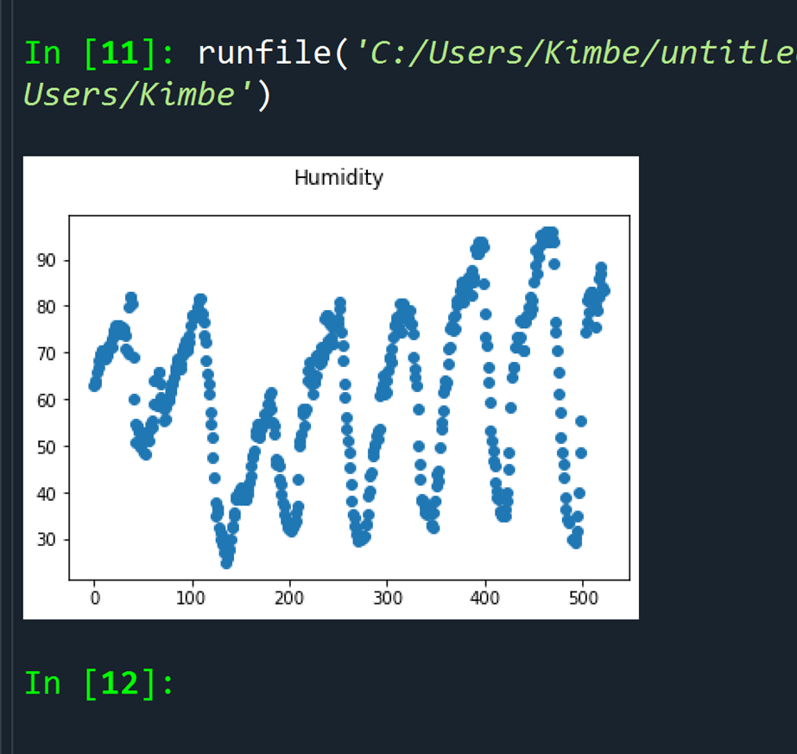
Analysis- Self Challenge
Create a question and develop a chart that answers that question.
Question: As the weather continues to get colder with the humidity levels increase or decrease over the next week?
Answer supported by Chart: This chart shows the humidity levels have varying points of increase in severity and clustered times. I think it shows that as we move into the colder months in the weeks ahead we should expect the humidity levels to increase in both the length and severity.

Slide 14
Prediction
Develop a prediction based on the data. What variations in temperature and humidity do you expect over the next few hours or days? How would humidity change if temperature goes up or down?
Based on all three charts provided we can expect that temperatures will continue to fluctuate in the next coming days and the humidity levels will continue to cluster together in variances. Colder temperature and higher humidity in my area would lead to snow fall. This will be an interesting experiment to see if snow does fall in the next week or so as we typically do not receive snow until January or February.

Slide 15
Conclusion
Using Pyhton, SQL and Excel together we are able to create a pull between different types of data to form informative charts, spreadsheets and files. Although we used weather data for this project, we can use the same process for a multitude of different types of data.

Slide 16
Project Challenges
This project was all around an enjoyable experience. I didn’t find any hard challenges that I wasn’t able to quickly and effectively resolve.
There we a few stumbling blocks resulting from improper file location placements. Those were easily resolved.

Slide 17
Skills Obtained
Moderate knowledge of Python
SQL Query
Extraction and processing of database files
Chart generation with Excel
Plot generations in Python

